Slide 1

Digitalized Bus Pass System
Yash Mathur, Falguni, Subhasmita, Ishan
Under Supervison of
Internal: Ms. Ruchika Bakhar
School of Engineering and Technology
Internal: SupeErNvSIi1s5o2 r name,1/E11xt
Yash, Falguni, Subhasmita, Ishan Digitalized Bus Pass

Slide 2
Introduction
Overview
Idea
The project deals with generating the solution for bus pass
After waiting for 30 mins in long queue outside the accounts as well as transport office to get the stamp and transport form.
It would be quite easier to just carry the form in phones get it filled after every semester and get you digital bus pass on your phone after getting approval from the accounts office that too digitally.
Internal: SupeErNvSIi1s5o2 r name,2/E11xt
Yash, Falguni, Subhasmita, Ishan Digitalized Bus Pass

Slide 3
Survey And Results
Survey Questions
Do You Face any problems regarding the form submission of bus pass?
Do you want route navigation option on academia so that you can easily track your bus route?
Is there any requirement for getting updates on bus merge?
Internal: SupeErNvSIi1s5o2 r name1,1/E11xt
Yash, Falguni, Subhasmita, Ishan Digitalized Bus Pass

Slide 4
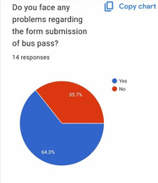
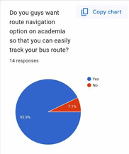
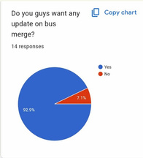
Survey And Results
Survey Responses
Internal: SupeErNvSIi1s5o2 r name1,1/E11xt
Yash, Falguni, Subhasmita, Ishan Digitalized Bus Pass

Slide 5
Problem Statement
The current bus pass application process in our college is manual, causing long queues and crowding due to form verification at the accounts office before submission at the transport office. This leads to delays, errors, and inconvenience. A digitalized system is needed to streamline the process and reduce physical congestion.
Internal: SupeErNvSIi1s5o2 r name,4/E11xt
Yash, Falguni, Subhasmita, Ishan Digitalized Bus Pass

Slide 6
Objectives
Main objective of this project will be
Getting Digitalized bus pass.
Updates over bus merge.
Designing a feature for bus navigation.
Internal: SupeErNvSIi1s5o2 r name,3/E11xt
Yash, Falguni, Subhasmita, Ishan Digitalized Bus Pass

Slide 7

Metho dology
We will be creating a website using:
1
2 3
Front-end: HTML , CSS
Back-end: Java Script, Python,node.js
Database: MySQL
Designing: Figma, Canva
Internal: SupeErNvSIi1s5o2 r name,5/E11xt
Yash, Falguni, Subhasmita, Ishan Digitalized Bus Pass

Slide 8
Key Features of project
Online Application Form
Students can fill out and submit the bus pass application digitally.
Account Verification Integration
Automatic fee status check through integration with the accounts department.
Admin Dashboard
For transport and accounts office staff to review, approve, or reject applications.
Digital Pass Generation
Approved students receive a QR-based or PDF bus pass.
Status Tracking
Students can track the real-time status of their application.
Email/SMS Notifications
Alerts for submission, approval, rejection, or pending actions.
Secure Login System
Login for students and staff using college credentials.
Data Storage and Record Management
Centralized database for all applications and issued passes.
Internal: SupeErNvSIi1s5o2 r name1,1/E11xt
Yash, Falguni, Subhasmita, Ishan Digitalized Bus Pass

Slide 9
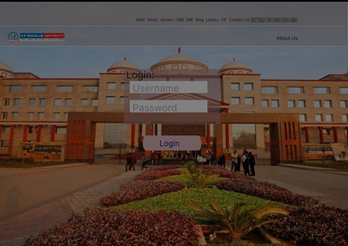
ScreenShots of project
The prototype designed on figma for the front screen to look exactly like KRMU official page
Internal: SupeErNvSIi1s5o2 r name1,1/E11xt
Yash, Falguni, Subhasmita, Ishan Digitalized Bus Pass

Slide 10
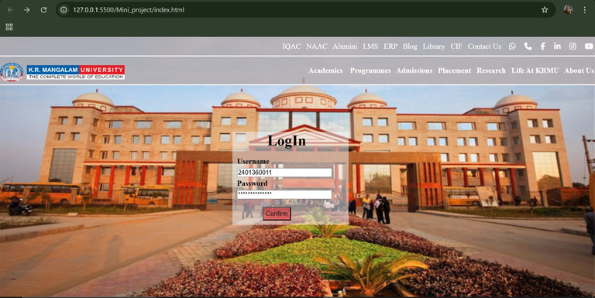
ScreenShots of project
Internal: SupeErNvSIi1s5o2 r name1,1/E11xt
Yash, Falguni, Subhasmita, Ishan Digitalized Bus Pass

Slide 11
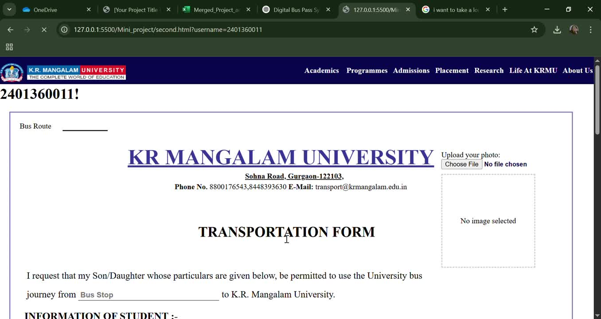
ScreenShots of project
Internal: SupeErNvSIi1s5o2 r name1,1/E11xt
Yash, Falguni, Subhasmita, Ishan Digitalized Bus Pass

Slide 12
Future Work
To complete the backend of the code.
which includes connecting it to a database, and naming each table according to bus route.
Using AI ML to get approval from accounts office to generate bass pass.
To make the website responsive.
Internal: SupeErNvSIi1s5o2 r name,9/E11xt
Yash, Falguni, Subhasmita, Ishan Digitalized Bus Pass

Slide 13
Conclusion
This mini project aims to develop a Digitalized Bus Pass System for our college to replace the existing manual process. The current system causes crowding and delays due to physical form submissions and manual verifications. The proposed solution provides a digital platform where students can apply for bus passes online, get fee verification automatically from the accounts department, and receive a digital pass upon approval. This system enhances efficiency, reduces manual workload, and avoids physical queues.
Outcomes
Reduced crowding and queues at transport and accounts offices.
Faster and more efficient bus pass application and approval process.
Easy tracking of application status for students.
Centralized digital record of issued passes.
Improved coordination between departments.
Eco-friendly solution by reducing paper usage.
Internal: SupeErNvSIi1s5o2 r name,9/E11xt
Yash, Falguni, Subhasmita, Ishan Digitalized Bus Pass

Slide 14
Thankyou
Internal: SupeErNvSIi1s5o2 r name1,1/E11xt
Yash, Falguni, Subhasmita, Ishan Digitalized Bus Pass

